Slide 1



emotion
Melody
Stays!!
plays

Slide 2


Collaboraters
Sowjanya
AP23110011593
Harshitha
AP23110011657
AP23110011656
Sravani
Jagan Mohan Reddy
AP23110011664

Slide 3

Introduction
"Emotion-Based Music Player" is a Python-based application that seeks to bridge the gap between a user's emotional state and music by automatically detecting facial expressions and playing music that corresponds to the detected mood.
Let’s start!

Slide 4

Let’s figure it out

Slide 5

Objectives :
To detect user emotions through facial expressions using computer vision.
To play music that matches the user's current mood.
To track and show mood patterns over time.
To control the music player using voice commands.
To provide a smooth and easy-to-use experience in real time.

Slide 6
Methodology:
MethodologyFace Detection (OpenCV):Captures live video and detects the user’s face using OpenCV.
Emotion Recognition (DeepFace):Analyzes the face to identify the user's emotion like happy, sad, or angry.
Music Selection (Pygame):Plays music from a mood-based playlist using Pygame.
Voice Control (SpeechRecognition):Lets users control the player with voice commands like play, pause, or skip..

Slide 7
Let’s check out the code

Slide 8
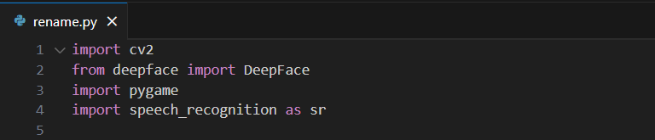
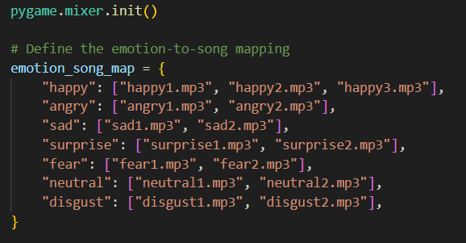
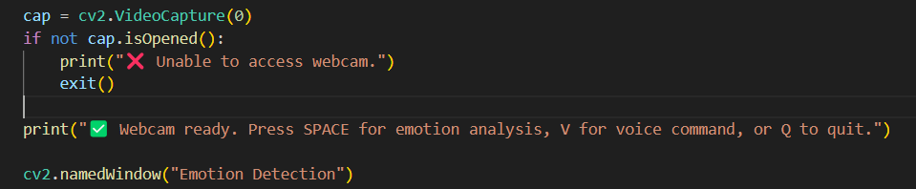
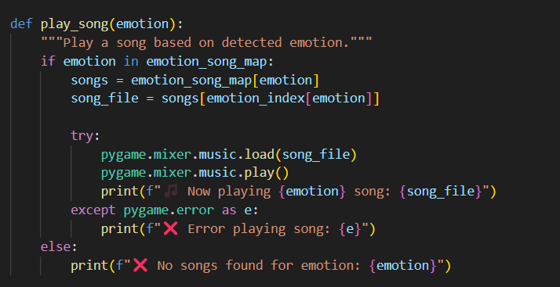
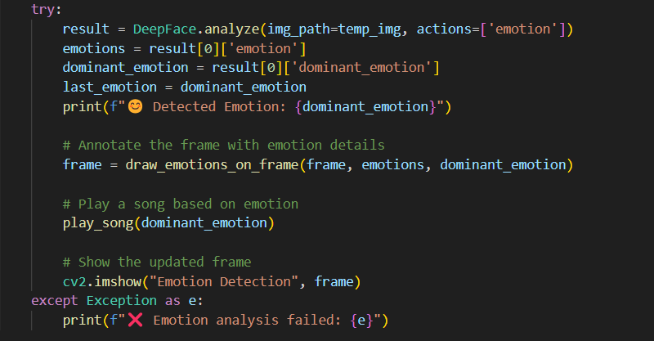
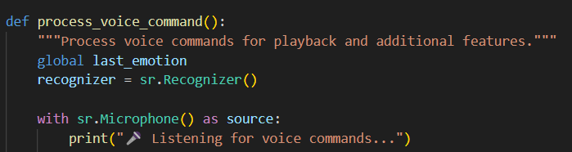

Slide 9
Conclusion:
This project demonstrates how emotion recognition can enhance user experience by delivering personalized music and activity suggestions. It successfully blends computer vision, audio playback, and voice interaction, laying the foundation for emotionally intelligent applications. With future improvements, it holds promise for use in mental wellness, entertainment, and adaptive user interfaces.

Slide 10
Result:
Detected real-time facial emotions using webcam.
Played emotion-matched songs automatically.
Responded to voice commands like play, pause, stop, and next.
Suggested mood-based activities.
Smooth integration of vision, audio, and speech modules.

Slide 11
THANK YOU
FOR PLAYING!

